Slide 1
Technical Communication in the Workplace

Slide 2
Research Introduction
Topic
Research Objectives
Topic selection
Defining a topic
Identifying resources
What is the quest? the learning outcomes?
Listing them clearly
Focus on the problem understanding
Unbiased and neutral

Slide 3
Before starting your research, you ask yourself the following questions, to give direction to your work:
What questions must be answered during the research phase?
What information might be most useful?
What print and electronic sources would be most appropriate?
What format must be used to document material borrowed from sources?

Slide 4
Secondary Research
Topic
Research Objectives
Secondary Research
Authenticity
Credibility
Relevance
Scope
Topic selection
Defining a topic
Identifying resources
What is the quest? the learning outcomes?
Listing them clearly
Focus on the problem understanding
Unbiased and neutral
Review of the existing literature, information.
Being curious. Ignoring existing research can point to arrogance.
Books
Journals
Research papers
Documentaries
Podcasts

Slide 5
Respondent’s profile
Topic
Research Objectives
Secondary Research
Target Audience
Topic selection
Defining a topic
Identifying resources
What is the quest? the learning outcomes?
Listing them clearly
Focus on the problem understanding
Unbiased and neutral
Review of the existing literature, information.
Being curious. Ignoring existing research can point to arrogance.
Respondent profiles
Who is my right audience?

Slide 6
Primary Research
Interviews
Focus groups
Surveys/Questionnaires
Laboratory experiments, or field observations
Original works such as diaries, company reports, and correspondence, as well as documents that are the subject of analysis, such as user’s manuals and Web sites.
Qualitative
Quantitative

Slide 7
Quantitative
Qualitative
Quantifyable data that can be analyzed
Quantitative research collects data that can be represented in numbers.
Qualitative research analyzes words, images, processes, or objects
Information observed through conversations, (field) observations, anecdotal evidence

Slide 8
Designing a questionnaire I
Introduction
Filter question
Guidelines
Sequence, skips
Classification (target audience)
Close
Validity; it measures what it was designed to measure.
Reliability; it can be repeated with the same results.
Notes:
Morals
Personal principles of right and wrong.
Shaped by culture, religion, upbringing, or personal beliefs.
Ethics
Systematic rules or standards of right conduct.
Often tied to a professional or social framework (like medical ethics, business ethics, legal ethics).
More external and codified.

Slide 9
Designing a questionnaire II
Using Questionnaire and Interviews:
Keeping reader’s need while preparing the questionnaire
It benefits them personally or professionally/it is easy to fill out and return
Write a precise purpose statement
E.g. “The purpose of this survey is to find out ways in which…..”
Limit the number of questions
Every question must serve the purpose/ resist the temptation to clutter questionnaire with irrelevant questions
Ask mostly objective questions
So that the questions are easy to answer and responses are easy to compile
Notes:
Morals
Personal principles of right and wrong.
Shaped by culture, religion, upbringing, or personal beliefs.
Ethics
Systematic rules or standards of right conduct.
Often tied to a professional or social framework (like medical ethics, business ethics, legal ethics).
More external and codified.

Slide 10
Designing a questionnaire III
Types of Questions | Examples
Either/Or Questions | Would you or your technical staff find it useful to receive a technical newsletter on acid rain? Yes No
Multiple Choice Questions | If you answered “yes” to preceding question, what publication schedule would best meet your needs: Monthly Quarterly yearly
Grade-Scale Questions
Short-Answer Questions | List any environmental newsletters you already receive that you find helpful in business.
I find it very easy to start conversations with strangers
Strongly Agree | Agree | Disagree | Strongly Disagree

Slide 11
Designing a questionnaire IV
Provide clear questions that are easy to answer:
Avoid four common problems:
Biased in phrasing
Use of undefined terms
Use of more than one variable
Questions that require too much homework
Include precise and concise instructions at the top of the form
Test the questionnaire on a sample audience (Pilot)
Notes:
Morals
Personal principles of right and wrong.
Shaped by culture, religion, upbringing, or personal beliefs.
Ethics
Systematic rules or standards of right conduct.
Often tied to a professional or social framework (like medical ethics, business ethics, legal ethics).
More external and codified.

Slide 12
Format
Date
Address
Subject Line
Salutation
Body
Regards
Your name
Contact Information
Information presented differently in memo, letter and email.
Objective
Dear / Respected / Hi
Abstract/ Opening
Boday
Closing
Reason/Purpose explained
Reasons/Evidence
Call to action/Closing/Summary
Courteous close and sender details

Slide 13
Technical Communication in the Workplace

Slide 14
Correspondence Guideline 1: Know Your Purpose
Before beginning → write down your purpose in one clear sentence.

Slide 15
What is the purpose in below correspondence:
“As you requested yesterday, I am sending samples of the new candy brands you are considering placing in M-Global’s office vending machines.”

Slide 16
What is the purpose in below correspondence:
“As you requested yesterday, I am sending samples of the new candy brands you are considering placing in M-Global’s office vending machines.”
Purpose

Slide 17
What is the purpose in below correspondence:
This letter explains M-Global’s new policy for selecting rental cars on business trips.

Slide 18
What is the purpose in below correspondence:
This letter explains M-Global’s new policy for selecting rental cars on business trips.

Slide 19
What is the purpose in below correspondence:
I have attached the most recent draft of the proposal for the PI Corp. pipeline project.

Slide 20
What is the purpose in below correspondence:
I have attached the most recent draft of the proposal for the PI Corp. pipeline project.
Purpose: Implied?

Slide 21
Correspondence Guideline 1: Know Your Purpose
Before beginning → write down your purpose in one clear sentence.
Correspondence Guideline 2: Know Your Reader
Who are you trying to inform or influence? Affects the vocabulary you choose, the arguments you make, and the tone you adopt.

Slide 22
What is the purpose in below correspondence:
Who are you trying to inform or influence?
“As you requested yesterday, I am sending samples of the new candy brands you are considering placing in M-Global’s office vending machines.”
Tone?
Wording?
Audience?

Slide 23
What is the purpose in below correspondence:
Who are you trying to inform or influence?
“As you requested yesterday, I am sending samples of the new candy brands you are considering placing in M-Global’s office vending machines.”
Professor / Manager
Tone? Respectful, Formal
Wording? Formal, Proper
Audience? Senior

Slide 24
What is the purpose in below correspondence:
Who are you trying to inform or influence?
This letter explains M-Global’s new policy for selecting rental cars on business trips.
Tone?
Wording?
Audience?

Slide 25
What is the purpose in below correspondence:
Who are you trying to inform or influence?
This letter explains M-Global’s new policy for selecting rental cars on business trips.
Internal company staff
Tone? Informative, Professional
Wording? Proper, Formal
Audience? Known, Group

Slide 26
What is the purpose in below correspondence:
Who are you trying to inform or influence?
I have attached the most recent draft of the proposal for the PI Corp. pipeline project.
Tone?
Wording?
Audience?

Slide 27
What is the purpose in below correspondence:
Who are you trying to inform or influence?
I have attached the most recent draft of the proposal for the PI Corp. pipeline project.
Email b/w colleagues
Tone? Conversational
Wording? Less formal
Audience? Known, Individual

Slide 28
Correspondence Guideline 1: Know Your Purpose
Before beginning → write down your purpose in one clear sentence.
Correspondence Guideline 2: Know Your Reader
Who are you trying to inform or influence? Affects the vocabulary you choose, the arguments you make, and the tone you adopt.
Correspondence Guideline 3: Follow Correct Format
Correspondence Guideline 4: Follow the ABC Format for All Correspondence
Organizing correspondence: Abstract (Objective) → Body (Content) → Conclusion (Summary)
Correspondence Guideline 5: Use the 3Cs Strategy
Capture (Ask/Reason/Hook) → Convince (support/action) → Contact (Way-forward)

Slide 29
Correspondence Guideline 6: Stress the “You” Attitude
From your reader’s perspective: What will interest my reader?” and “What does my reader want to accomplish?”
Correspondence Guideline 7: Use Attachments for Details
Correspondence Guideline 8: Be Diplomatic Authentic & Respectful
Correspondence Guideline 9: Edit Carefully
Review: Does it convey the message? Spell check, grammar, sentence structure etc.
Correspondence Guideline 10: Respond Quickly

Slide 30
Types of Messages
Neutral, Routine, Positive, Good will messages
Bad news, Negative messages
Persuasive messages

Slide 31
Types of Messages
Neutral, Routine, Positive, Good will messages
■ Letter replying to a question about products or services
■ Letter responding favorably to a complaint or an adjustment
■ Letter hiring an employee
■ Announcing high bonuses for the year
■ Commending an employee for performance on a project
■ Requesting information about a product or service
■ Inviting the reader to an event
■ Summarizing the results of a meeting with a client
■ Explaining a new laboratory procedure

Slide 32
Types of Messages
Bad news, Negative messages
■ Explaining delays in projects or delivery of services
■ Letter refusing to make adjustments based on complaints
■ Letter giving bad news about employment or performance
■ Reporting decreased quarterly revenues for the year
■ Requesting closer attention to filling out timesheets
■ Email asking for volunteers to work on a holiday

Slide 33
Types of Messages
Persuasive messages
■ Starting a business relationship
■ Registering complaints about products or services
■ Letter seeking repeat business (Sales)
■ Requesting funding for a training seminar
■ Explaining policy changes that may be perceived negatively
■ Encouraging employees to follow required procedures

Slide 34
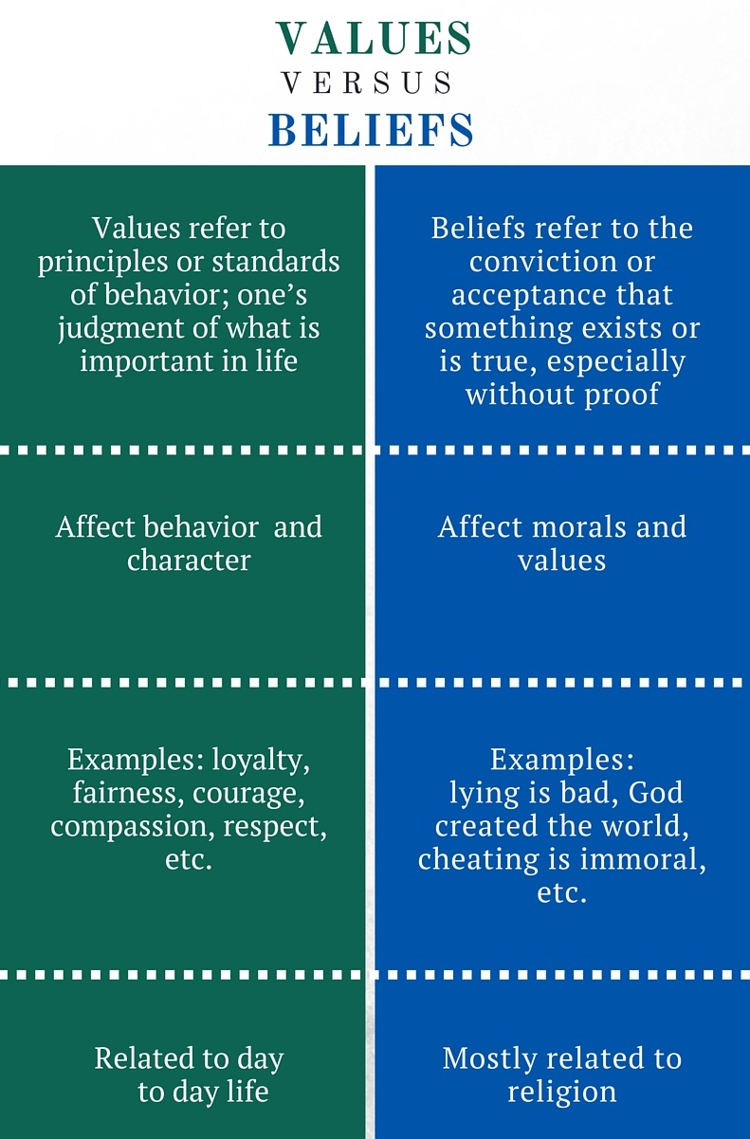
Organizational culture
refers to a
system of shared meaning
that includes
values, beliefs, and assumptions that characterize the organization
Values of companies - examples? Nike, Coke, FAANG, SpaceX
Assignment: Look up the values of the company you dream to work for or take inspiration from for your company.

Slide 35
Understanding Cultures
All cultures have both common features and distinctive differences that must be studied. People in different cultures have different ways of thinking, different ways of acting and different expectations in communication.
One of the ways to study cultural differences is through the concepts of high-context cultures and low-context cultures.

Slide 36
High-Context Cultures
High-context cultures are fairly homogeneous, with the culture providing a high degree of context for communication. Thus, communications may be less explicit because members of the culture share characteristics such as religion, ethnic background, and education. Japan is an example of high-context culture.
Important characteristics of high-context cultures include:
Community based; difference between insiders and outsiders
A focus on maintaining relationships, on saving face, and on helping others save face
A dependence on internalized cultural norms to govern behavior.

Slide 37
Low-Context Cultures
Low-context cultures consist of diverse religions, ethnic backgrounds, and educational levels; as a result, communication must be explicit, because members of a group cannot assume that they share knowledge or attitudes. The culture provides a low degree of context for communication. The United States is an example of a low-context culture.
Important characteristics that affect communication in low-context cultures include
More individualistic, easier to enter
A focus on actions and solving problems, with a willingness to disagree openly
A dependence on formally established rules to govern behavior

Slide 38
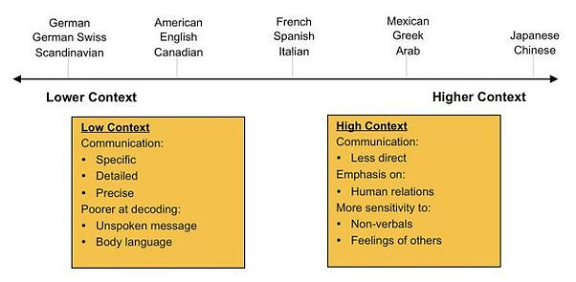

Slide 40

The concept of low-context and high-context cultures offers a general way of thinking about how to relate to clients and colleagues in other cultures and countries, but if you find yourself working in a global, intercultural setting, you should understand the specific cultural practices of those you are working with.

Slide 41
Guidelines for Communicating Internationally
Simplify grammar and style rules
Use simple verb tenses and verb constructions.
Limit vocabulary to words with clear meanings.
Use language and terminology consistently; per meaning.
Define technical terms.
Avoid slang terms and idioms.
Include visuals. Graphics are
Notes:
Following are some basic guidelines to reduce the risk of misunderstanding:
When writing documents for other cultures, remember that your work will not be read in the cultural context in which it was written.
For that matter, you may lose control of the document altogether if it is translated into a language that you do not know.

Slide 42
Case Study: Intercultural Communication in a Global Business Environment
GlobalTech Solutions (GTS) is a multinational technology company headquartered in the United States, with offices in Europe, Asia, and South America. The company specializes in software development, IT consulting, and digital transformation services. GTS recently acquired a smaller tech firm, TechInnovate, based in Pakistan, to expand its market presence in Asia. As part of the acquisition, GTS plans to integrate TechInnovate’s employees into its global operations. This integration involves a series of virtual meetings, cross-cultural training sessions, and collaborative projects between teams in the U.S. and Pakistan.
In the first virtual meeting between the U.S. and Pakistani teams, several communication issues arise. The American team notices that their Pakistani counterparts are unusually quiet during discussions. They rarely voice their opinions or disagree with any points made. Meanwhile, the Pakistani team feels that the American team is overly direct and somewhat aggressive in their approach, which makes them uncomfortable.
Notes:
Discuss in pairs and present answers to the class.

Slide 43
Key Players:
John Davis: Project Manager from the U.S. team, known for his direct communication style.
Saba Ali: Senior Developer from the Pakistani team, values harmony and prefers a consensus-driven approach.
Sarah Lee: HR Manager at GTS, responsible for overseeing the integration process.
Aslam Khan : HR Manager at TechInnovate, tasked with supporting the transition.

Slide 44
Questions:
Question 1: What are the key cultural differences in communication styles between the U.S. and Pakistani teams?
Question 2: How can GTS facilitate better communication between the teams?
Question 3:What strategies can John and Saba use to improve their collaboration?
Question 4: How can the HR managers, Sarah and Aslam, support a smoother integration process?

Slide 45
Cultural Differences: P. 10
Big picture vs. details | High-context vs. Low-context
Order vs. chaos | Monochronic vs. Polychronic
Formal vs. informal | Top-down communication vs. back and forth and up and down
Motivations and rewards | Personal achievement vs. financial rewards
Quality vs. quantity of decisions | methodical process
Giving and receiving feedback | Negative vs. positive feedback
Expressing opinions | Openly disagree
Role of managers | Egalitarianism vs. hierarchy
Willingness to sacrifice personal time | forgo personal time if needed.

Slide 46
Task:
Based on these variations in culture (P:10), select any two countries and compare these elements
Talk about at least 5 differences or similarities
Examples could be in form of images, videos or case studies
Submit a write up (350 words)

Slide 47
“Ethics is the discipline concerned with what is morally good and bad, right and wrong.”
Encyclopedia Britannica

Slide 48
Ethical behavior enables employees to act with equity, fairness, impartiality and respect for the rights of others.
Ethical business communicators make choices that enable them to:
Follow the organization's policies, procedures, guidelines and code of ethics
Communicate factual information objectively
Avoid using distortions of fact and misleading information
Respect the dignity of each person, irrespective of ethnic background, religion or gender

Slide 49
“Our product is just what you need”
“Our artificial sweetener is composed of proteins that occur naturally in the human body [amino acids].”
“Our Krunchy Cookies contain no cholesterol”
Such claims are technically accurate but misleading.
Amino acids in certain sweeteners can alter body chemistry and cause headaches, seizures and possible brain tumors
Processed food snacks often contain saturated fat and trans fats, from which liver produces cholesterol
In addition to being informative and persuasive, communicators must be ethical.
Notes:
Arguments can WIN without being ethical if they WIN at any cost

Slide 50
Ethics Guidelines
Tips
Be honest
Do no harm
Be fair
Honor intellectual property rights
Respect confidentiality
Be professional
Acknowledge sources for information other than Common Knowledge
Seek written permission before borrowing extensive text
Seek written permission before borrowing graphics
Seek Legal advice when you cannot resolve complex questions

Slide 51
Ethical Issues | Meaning | Examples
Suppression of Information | Burying to data to hide inconvenient truths | A company fails to reveal product-testing results that indicate potential danger to consumers
Falsification or fabrication | Changing or inventing data to support a desired outcome | A company boasts of a fictitious enterprise to lure investors into supporting a new venture
Overstatement or understatement | Exaggerating the positive aspects of a situation of downplaying negative aspects to create the desired impression | A public-opinion survey describes 55 percent of the respondents as a “substantial majority” and 45 percent as “a small percentage”
Selective misquoting | Deleting words from quoted material to distort meaning | A supervisor changes a report’s conclusion that “this proposal will seem feasible only to workers unfamiliar with the situation” to “this proposal will seem feasible.. to workers”
Subjective Wording | Using terms deliberately chosen for their ambiguity | A company advertises “customary service charges”, knowing that “customary” is open to broad interpretation.
Conflict of interest | Exploiting behind-the-scenes connections to influence decision-making | A board member of a community agency encourages the agency to hire her company for paid services rather than soliciting bids
Withholding information | Refusing to share relevant data with coworkers | A computer-savvy employee provides misleading answers about new software to make recently hired coworker appear incompetent
Plagiarism | Taking credit for someone else’s ideas, findings | An employee assigned to prepare a report written by someone at another company, downloaded from internet
Notes:
,

Slide 52
Salam & Bienvenue* TBW Fall 2025 Class!
About you
About me
About the course
Class rules
How should we best the make use of our time together?
*Welcome in French

Slide 53
Some rules to control the fun
Lets respect everyone’s time
Attendance - university’s 80% presence class rule (your responsibility)
Weightage and performance
Class participation
‘GPA: a measure of intelligence? Who would you hire someone reliable or hit-or-miss?
No cross talking please - allow everyone to speak
Say your name before you speak (until needed)
Clean up. Respect the education you are paying for.
Slides - may be? I will think about it. Read the book.
Class rep
Email addresses – google group

Slide 54
Your introduction
What do I know about
you? Or have heard
about you
What do you want to
tell me about yourself?
surprise me I’ve heard too much of I’d to and the course seemed easy AND I had to)
Curious to know what role social media has on today’s young generation?
What do you want to be? Who you are? Do you recognize the privilege you have? What excites you?
Gen Z.
Have little interest in extracurricular

Slide 55
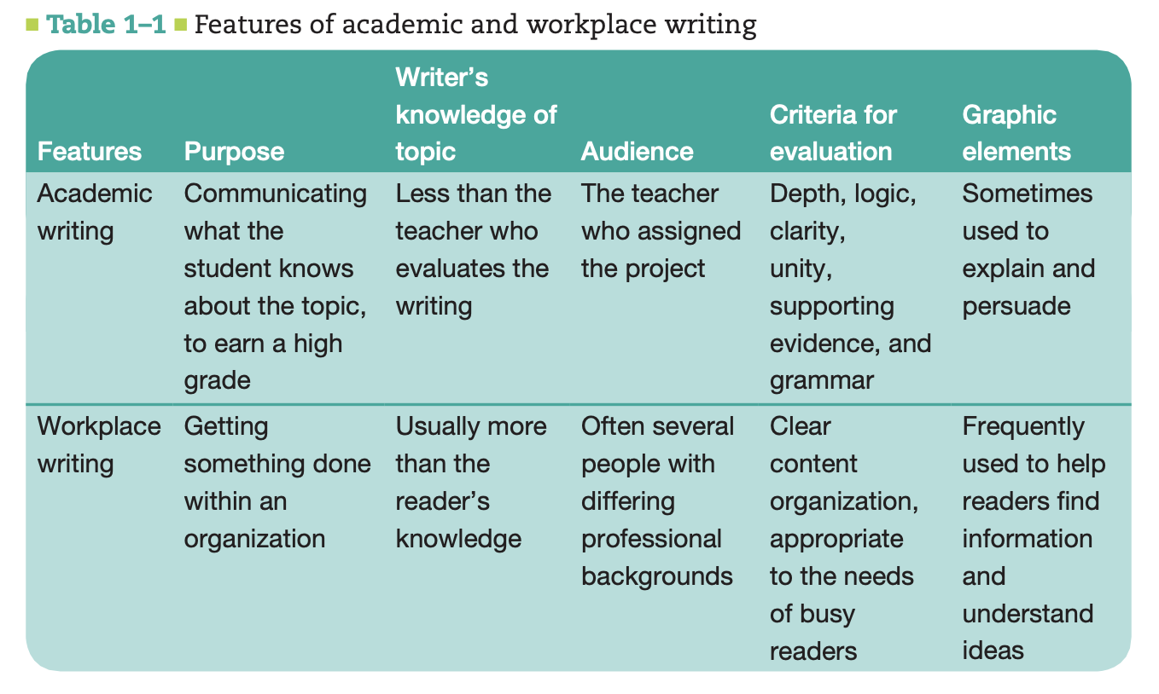

Slide 56
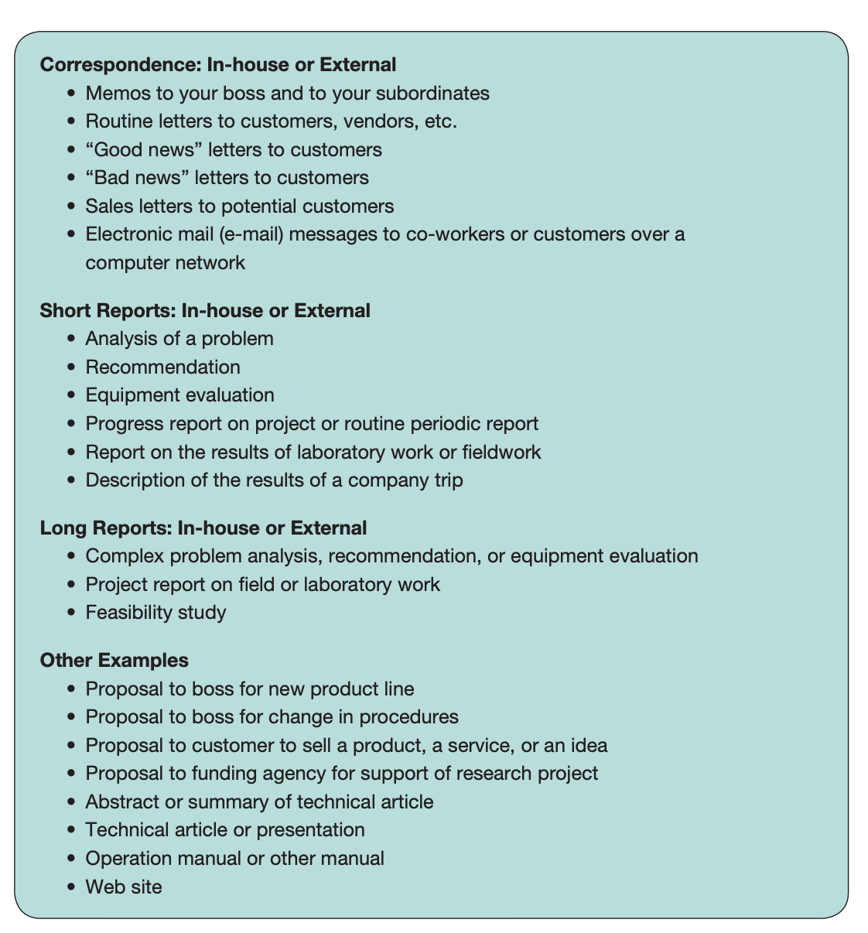

Slide 57
Business Climate
The economic and political factors that influence an organization’s priorities, plans, and activities.
These factors include competition, investor interests, regulations, and the overall health of the economy.
Two practices that are being used more often in the global business climate are outsourcing and offshoring…
Notes:
An organization’s culture is not isolated from the cultures of other organizations, or from the wider culture or cultures in which it is located. Organizations, especially businesses and corporations such as M-Global, must respond to the business climate. To compete in today’s global business climate, companies are focusing on quality and efficiency.

Slide 58
Outsourcing
the practice of purchasing goods or subcontracting services from an outside company. Both the client company and the company that is providing the goods or services may be in the same country, or they may be in different countries.
Offshoring
Happens when a company moves some of its operations to another country. This practice is often done to reduce labor costs, but it may also help a company work more efficiently by creating offices closer to suppliers or clients
Notes:
Although both practices are changing the workplace, they also offer opportunities for companies and employees who are prepared for the global marketplace.

Slide 59
Globalization
A process in which → worldwide integration and interdependence is promoted across borders
Driving factors: Telecommunication, internet + Transport, infrastructure
Is that true for Pak? Where are we in the process of globalization? What disadvantages/advantages does it present? Comparison to the Neighbour, Middle east, NA, Europe?

Slide 60
Diversity
Globalization has resulted in increased diversity at workplaces
How does diversity help? (Some: talent attraction, better service audience needs, shareholder values, profits)
Diversity is good, hence we should learn to be inclusive
We need to stress that all human cultures have common needs, a common sense of humanity.
But there are differences, too. How in the world do you please a customer, for example, if
you don’t know what he or she values? That’s what culture is all about, that’s what
differences are all about. Diversity assumes not only that people are different—we know
that—but that their difference is value-added. If you know how to harness that difference,
you’ll be more competitive as a corporation than those firms that don’t, whether in the
domestic marketplace, and certainly in the global marketplace.37
Inclusion

Slide 61
Elements of Organization Culture
Organization History
Type of Business
Management Style
Notes:
An organization’s culture is influenced by the firm’s history, type of business, management style,
values, attitude toward customers, and attitude toward its own employees. Taken together, all features of a particular organization’s culture create a definable quality of life within the working world of that organization.

Slide 62
